Slide 1


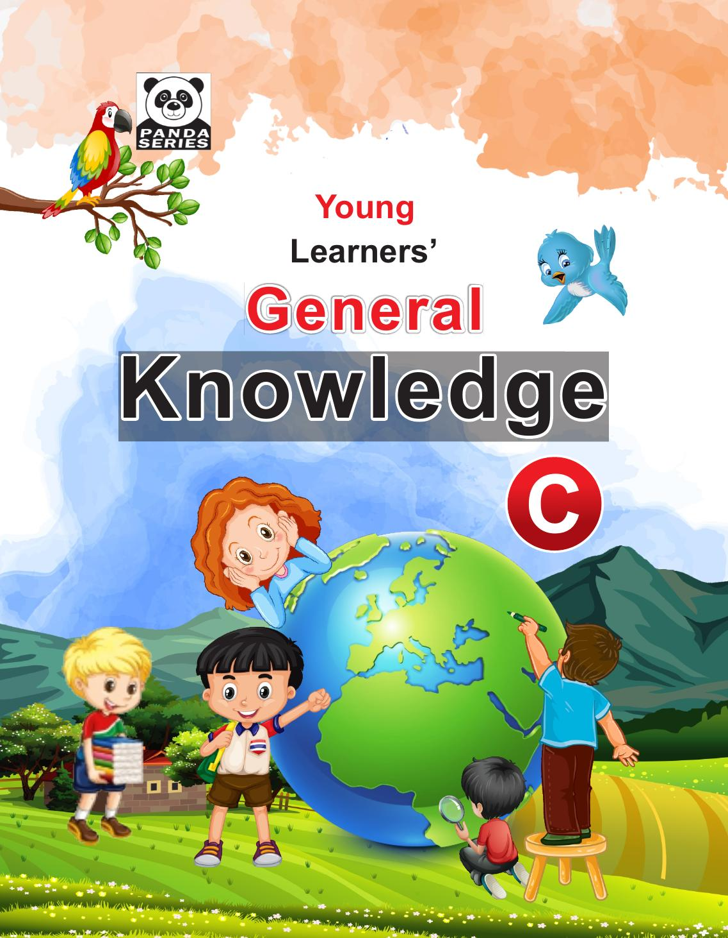
Panda General Knowledge — C
Playgroup • Age 3+
An activity-based early-years book from the Panda Series.
A Project of Azhar Publishers & Book Factory

Slide 2
i
What's Inside
Panda General Knowledge — C Playgroup • Age 3+
1
Myself and the five pillars of Islam
2
Pakistan, our cities and historical places
3
School, body parts and daily routine
4
Fruits, vegetables, birds and flowers
5
Provinces, dresses and professionals
6
Computer, months and traffic signals

Slide 3
★
Purpose & Classroom Support
Builds everyday general knowledge and national awareness through big pictures, simple questions and fun activities.
“
Every book comes with
1
2
3
Teacher's Lesson Plan
Practice Papers
Digital Interactive Version
A 40-week lesson plan that guides teachers, day by day.
Monthly tests and term exam papers for children to attempt.
An interactive flipbook and digital exercises for engaging, screen-based practice.
A Project of Azhar Publishers & Book Factory

